Slide 1
GIT and Github session 4
Harshee Pitroda – SURE Trust

Slide 2
The Areas of Git
There are four important areas to be aware of when you are working with Git:
• Working directory
• Staging area
• Commit history
• Local repository

Slide 3
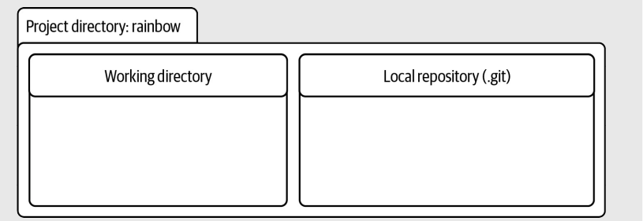
Working directory
The working directory contains the files and directories in the project directory that represent one version of a project.
ADD file
EDIT file
DELETE file/folder
In the case of the rainbow repository, the working directory is currently empty

Slide 4
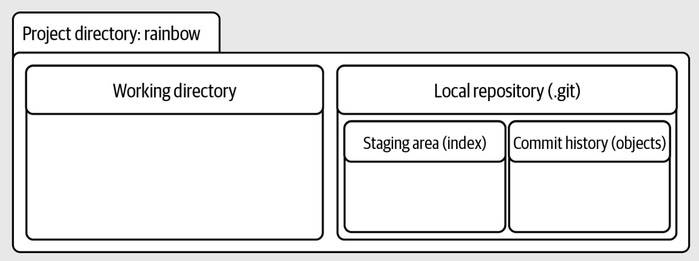
Within the local repository, there are two important areas we want to explore further: the staging area and the commit history.

Slide 5





































Staging area
The staging area is similar to a rough draft space. It is where you can add and remove files, when you are preparing what you want to include in the next saved version of your project (your next commit). The staging area is represented by a file in the .git directory called index

Slide 6
The index file is created only if you have added at least one file to the staging area in your project. In the rainbow project directory, you have not yet added any files to the staging area; therefore, the index file is not yet visible in the .git directory.

Slide 7
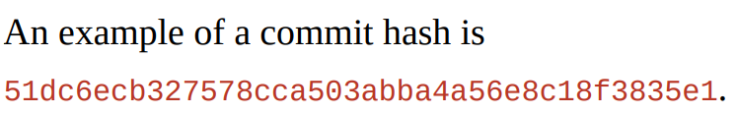
Commits
A commit in Git is basically one version of a project. You can think of it as a snapshot of a project, or a standalone version of a project that contains references to all the files that are part of that commit
Every commit has a commit hash (sometimes called a commit ID). This is a unique 40-character hash composed of letters and numbers that acts like a name for the commit, providing a way to refer to it.
In reality, you only need the first seven characters of a commit hash to refer to a commit. So, for the example hash just given, you can just use 51dc6ec to refer to the commit.

Slide 8
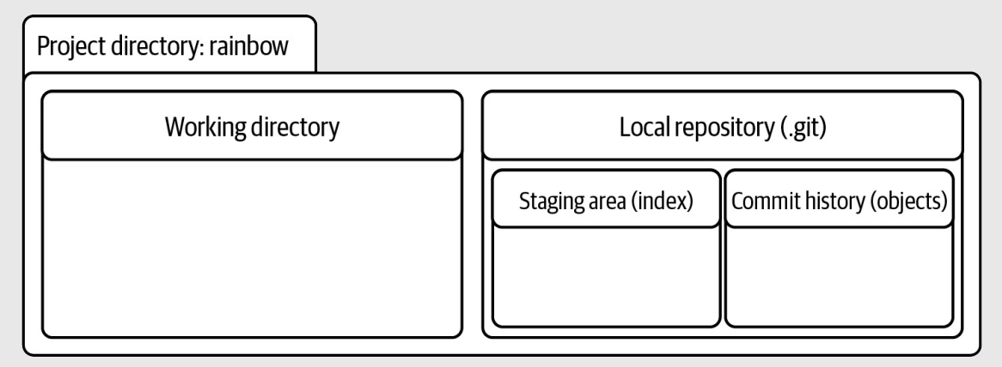
Commit history
The commit history is where you can think of your commits existing.
It is represented by the objects directory inside the .git directory.
To understand the commit history in depth we would have to dive into the internals of Git, but that is a complex topic that you don’t need to know about when learning the basics of how to use Git.
For our purposes, all you need to know is that every time you make a commit, it is saved in the commit history.

Slide 9
let’s add the first file to the Rainbow project and use a text editor to edit it.

Slide 10
Project: List the colours of the rainbow and some colors that are not part of the rainbow.
Every time you add a color, you will make a commit to keep track of how the project progresses.
Your first step will be to create a file called rainbowcolors.txt, in which you will list the colors
it is important that the filename does not include spaces.
add “Red is the first color of the rainbow.” on line 1 in that file.

Slide 11
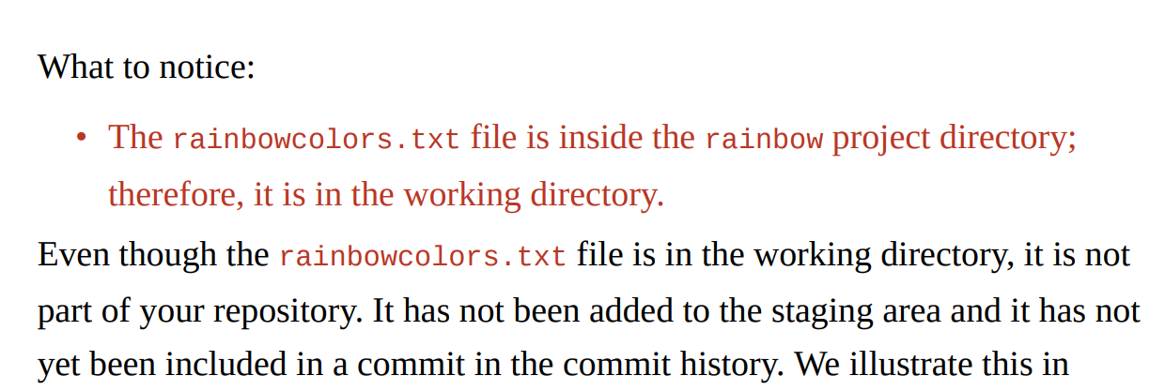




Slide 12
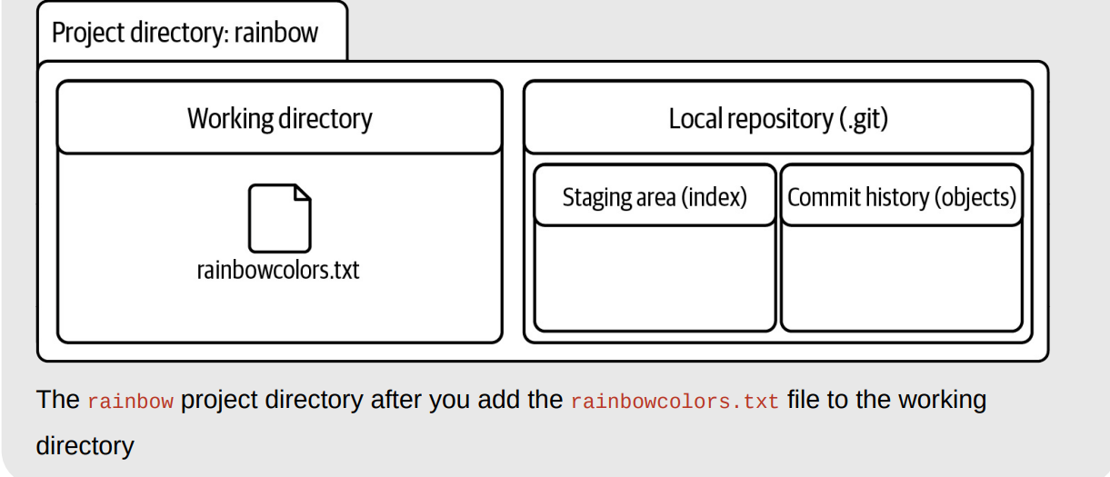

Slide 13
Since the rainbowcolors.txt file is not yet in your repository, it is an untracked file.
An untracked file is a file in the working directory that Git is not version controlling.
It has never been added to the staging area and it has never been included in a commit; therefore, it is not part of the repository.
Once you add a file to the staging area and include it in a commit, the file becomes a tracked file.
This is a file that is version controlled (in other words, a file that Git tracks).
Every new file in a project version controlled by Git needs to be explicitly added to the staging area and then included in a commit in order to become a tracked file.

Slide 14
MAKE A COMMIT

Slide 15
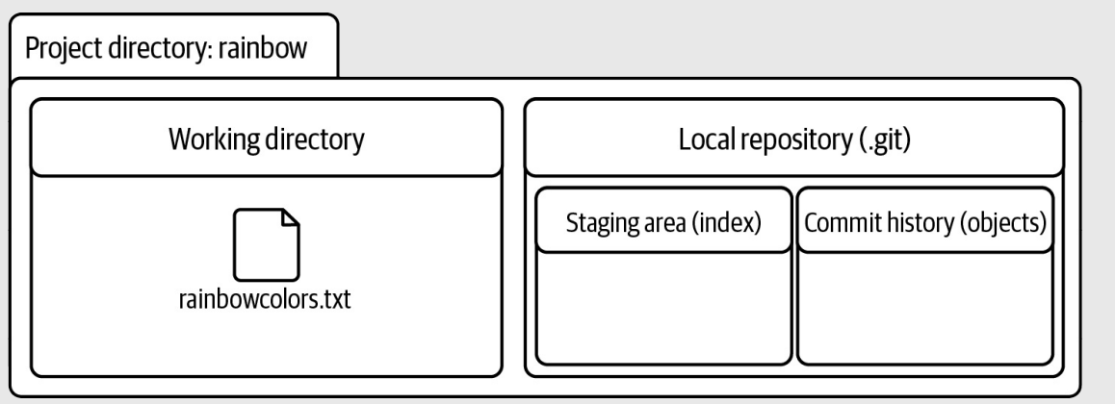
REVIEW OUR CURRENT SETUP
You now have a project directory called rainbow that has a .git directory inside it, and you also have one file, called rainbowcolors.txt, in your working directory.
The staging area and commit history are empty because you have not yet made any commits in the rainbow repository

Slide 16
Why Do We Make Commits?
A commit basically represents one version of a project.
Every time you want to save a new version of a project, you can make a commit.
Committing is important because it allows you to back up your work and avoid the frustration of losing unsaved work. Once you’ve made a commit, that work is saved, and you’ll be able to go back and look at that commit to see what your project looked like at that point in time.
In terms of when to make commits, there is no strict rule. This can depend on many factors, such as whether you’re working on a project on your own or with other people, and what type of project you’re working on (e.g., whether you’re writing code that needs to compile or documentation for a feature).
Finally, if you’re working in a team, it may depend on the workflow your team uses and what conventions that team has agreed to (for example, how they use branches)

Slide 17


A common adage in the world of Git is “commit early, commit often.” If you’re just getting started with Git, then I think this is good advice. At this stage, it is preferable to have too many commits than too few commits. Also, once you have a good grasp of Git basics, you can learn about additional tools that Git provides for cleaning up commits.

Slide 18
Two Steps to Make a Commit
Making a commit is a two-step process:
1. Add all the files you want to include in the next commit to the staging area.
2. Make a commit with a commit message.
Throughout this process you will be interacting with the four different areas of Git the local repository, the working directory, the staging area, and the commit history.
A useful command in the committing process is the git status command. Among other things, it tells you the state of the working directory and the staging area.
This is useful because in a project with many files it is easy to lose track of what state the files in your working directory are in (i.e., which ones you have edited) and which files you’ve added to the staging area.

Slide 19
The git status command only provides information; it never actually changes anything in your repository. Feel free to use it at any time while you’re working on a Git project to learn more about the state of your working directory and staging area

Slide 20
ADDING FILES TO THE STAGING AREA
To add files to the staging area, you use the git add command.
If you only want to add individual files that you have edited to the staging area, then you can pass in the filename or filenames to the git add command as arguments.
To add all the files you have edited or changed in your working directory, you can use the git add command with the -A option (which stands for “all”).
This may be helpful if you have edited many files and don’t want to write out each individual filename in the command line.

Slide 21
THANK YOU
Harshee Pitroda

